Slide 1
Migrations

Slide 2
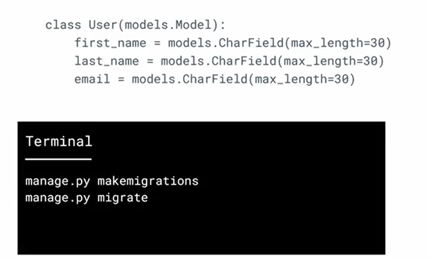
models.py

Slide 3
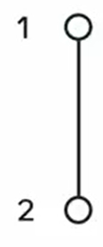
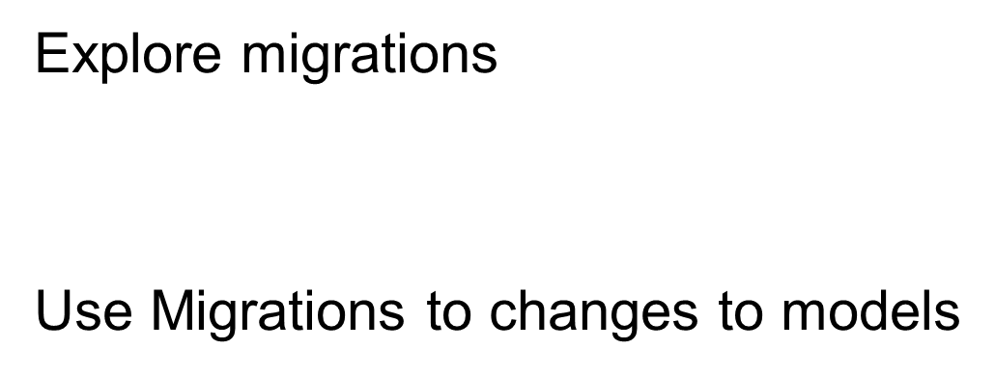

Slide 4
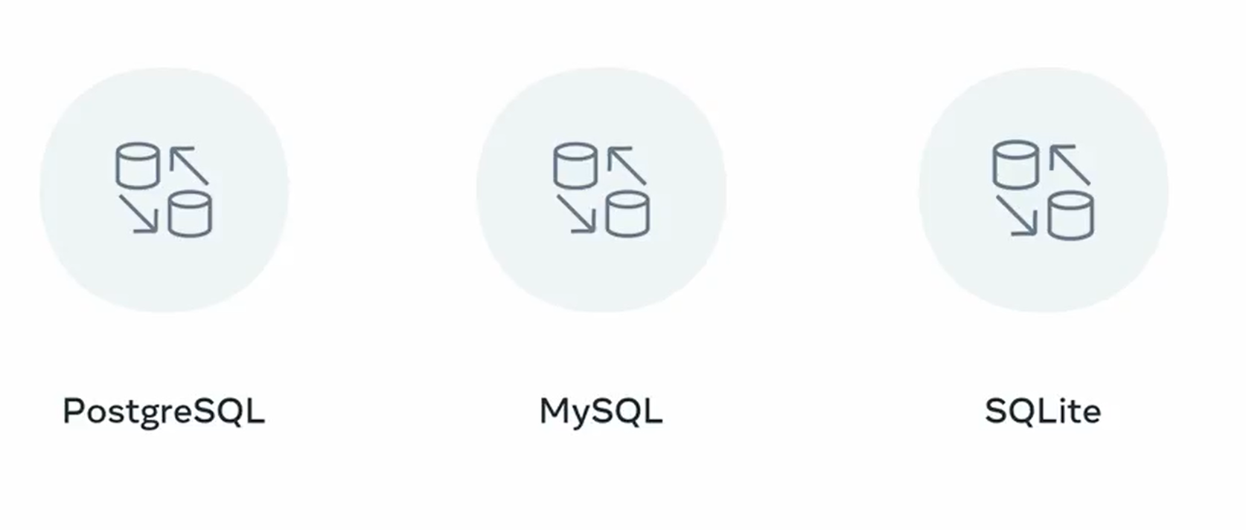

Slide 5
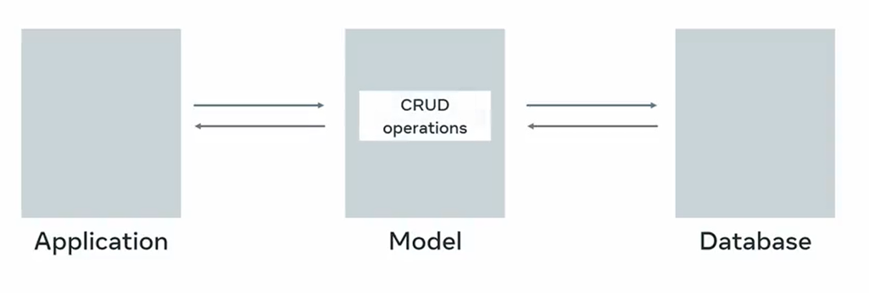
Django methods

Slide 6
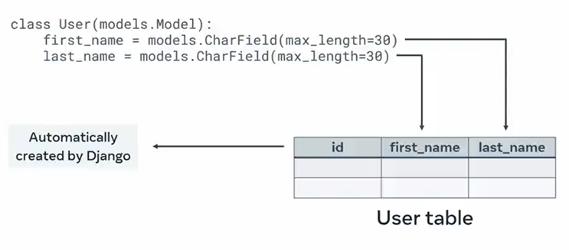
Object Relational Mapper

Slide 7
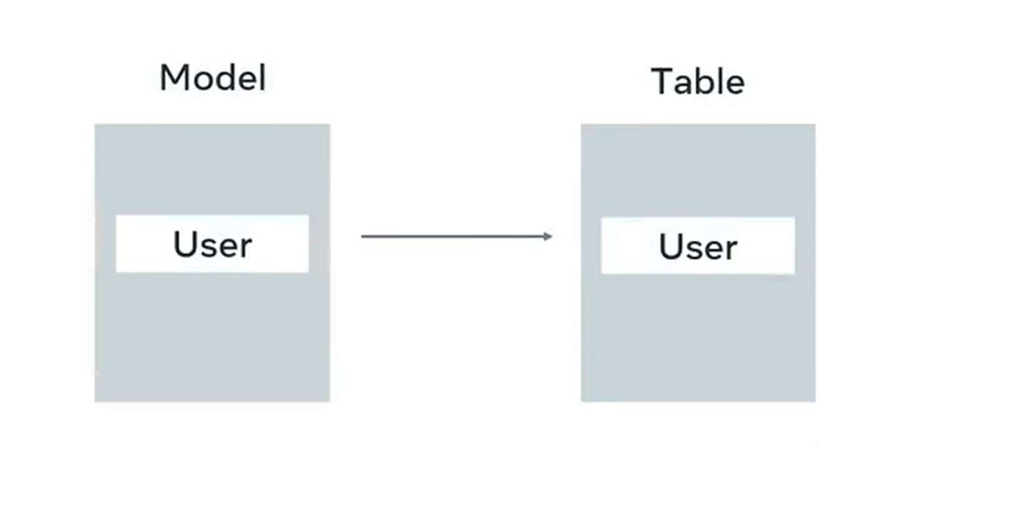

Slide 8
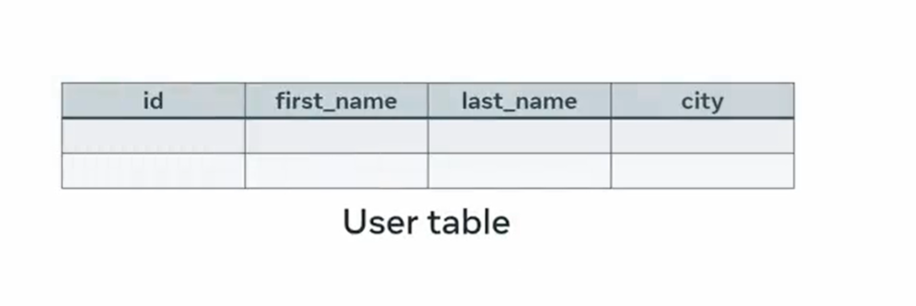

Slide 9


Slide 10


Slide 11

Migrations

Slide 12


SQL Alter statement
User table

Slide 13


User model
User table

Slide 14
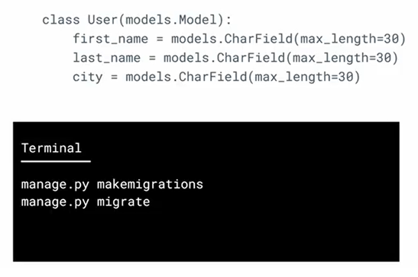
User model

Slide 15
